Slide 1
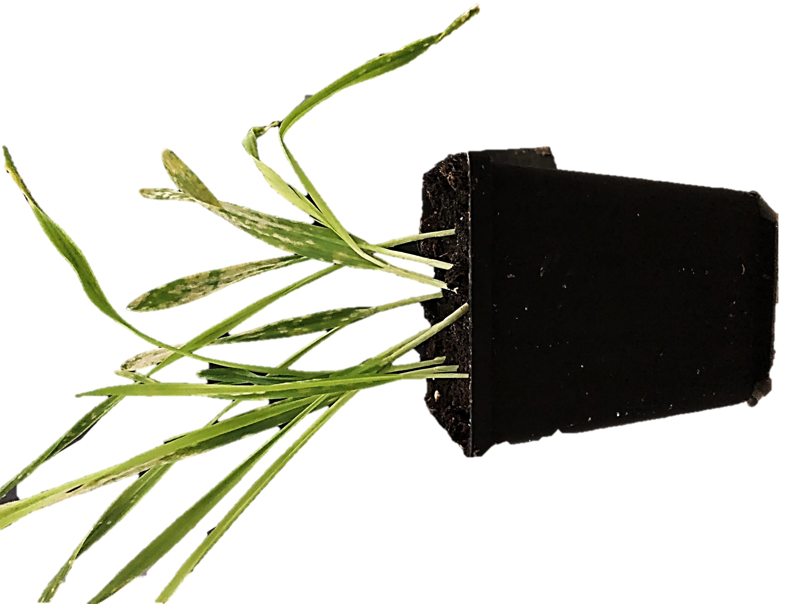

Slide 2
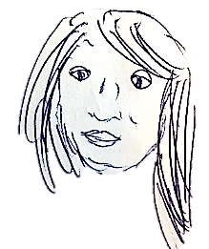
2021
Group Picture
PhD Student
Bachelor/
Master
student
Team Leader
Research Assistant
PostDoc
You?
You?
Isabel
TBD
You?

